Slide 1
Chapter 5 Transition Metals Higher Level
Wilt Gu

Slide 2
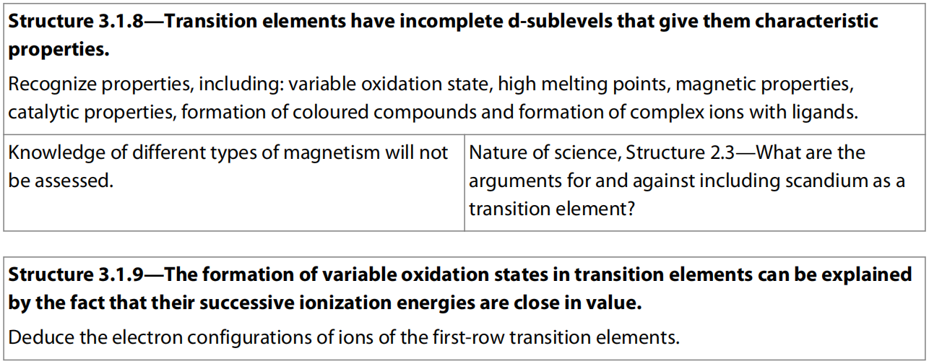
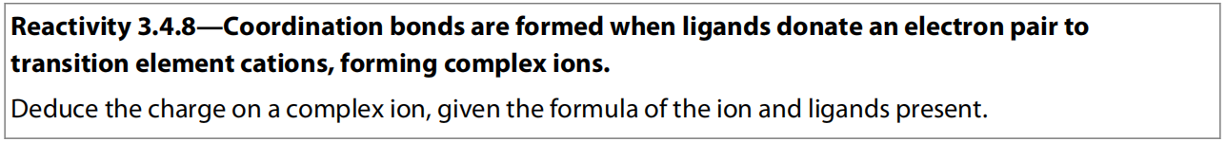
5.1 First row d-block elements

Slide 3
Electron Configuration - A Review
4s fills and empties before 3d
Fe
[Ar] 4s² 3d⁶
Cu
[Ar] 4s¹ 3d¹⁰
Fe³⁺
[Ar] 3d⁵
Cu⁺
[Ar] 3d¹⁰
Sc
[Ar] 4s² 3d¹
Cu²⁺
[Ar] 3d⁹
Sc³⁺
[Ar]
Zn
[Ar] 4s² 3d¹⁰
V
[Ar] 4s² 3d³
Zn²⁺
[Ar] 3d¹⁰
V²⁺
[Ar] 3d³
Cr
[Ar] 4s¹ 3d⁵

Slide 4
WHAT ARE TRANSITION METALS?
Transition metals are metals that contain an incomplete d sub-shell in atoms or ions.
Top row transition metals: Sc – Cu
Zn is not a transition metal (Zn & Zn²⁺ both have full 3d sub-shell)

Slide 5
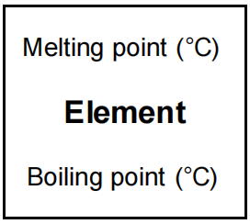
Physical Properties of Transition Metals
1) They have high m.p, b.p.,
and densities due to strong metallic bonds since some or all d electrons get involved.
Density (g cm⁻³)
K | Ca | Sc | Ti | V | Cr | Mn | Fe | Co | Ni | Cu | Zn | Ga | Ge
0.87 | 1.55 | 2.99 | 4.54 | 6.11 | 7.2 | 7.44 | 7.88 | 8.90 | 8.90 | 8.96 | 7.13 | 5.90 | 5.38

Slide 6
2. magnetic properties
Physical Properties of Transition Metals
Materials are classified as diamagnetic, paramagnetic, or ferromagnetic based on their behaviour when placed in an external magnetic field.
Diamagnetic: Materials that produce a very weak opposition to an applied magnetic field.
Paramagnetic: Substances which have unpaired electrons. They produce magnetization proportional to the applied magnetic field and in the same direction.
Ferromagnetic: Fe, Co, and Ni and their compounds. They have the largest magnetic effect, producing magnetizations sometimes with greater orders of magnitude than the applied field.

Slide 7
Most Transition metals and their complexes show paramagnetic properties
Magnetic Properties of Transition Metals
Transition metal complexes with unpaired electrons show paramagnetic properties as they are pulled into a magnetic field.
Transition metal complexes without unpaired electrons show diamagnetic properties as they are repelled away from a magnetic field.
Paramagnetic and diamagnetic complexes can be distinguished using the experimental arrangement shown below.

Slide 8
Magnetic Properties of Transition Metals
Paramagnetism increases with the number of unpaired electrons so generally increases from left to right across the Periodic Table, reaches a maximum at chromium, and decreases.
Zinc has no unpaired electrons and so is diamagnetic.
The presence of electron spin was first demonstrated in the Stern–Gerlach experiment.
A beam of silver atoms divided into two as it travelled through an electromagnetic field.
Atoms with the unpaired electron spinning moved in the opposite direction to those atoms with electrons spinning .

Slide 9
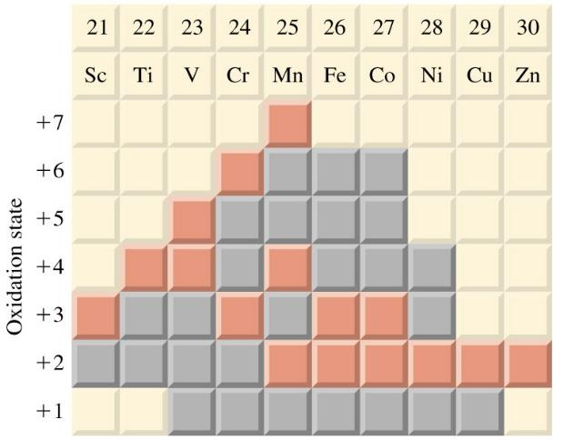
Chemical Properties of Transition Metals
1) They exhibit variable oxidation numbers.

Slide 10
Variable Oxidation Number of Transition Metals
One of the key features of transition metal chemistry is the wide range of oxidation numbers that the metals display in their compounds.
This should be contrasted with the s-block metals, which show only the oxidation state corresponding to their group number in their compounds.
Calcium, for example, only shows the +2 state whereas titanium shows the +4 , +3, and +2 states.
The difference in behaviour can be related to patterns in successive ionization energies.
Transition metals usually have close successive ionization energies so that they are likely to lose one more electrons or two without the need of huge amount of energy.

Slide 11
Variable Oxidation Number of Transition Metals

Slide 12
VARIABLE OXIDATION NUMBER OF TRANSITION ELEMENTS
The Ca³⁺ ion is energetically unstable because there is a large jump in ionization energy as the third electron is removed from the inner 3p orbital.
The increase in successive energies for titanium is more gradual as the 3d and 4s orbitals are close in energy.
Titanium shows the +2, +3, and +4 oxidation states.
A large jump occurs between the fourth and fifth ionization energies, as the inner 3p electron is removed, so titanium does not form the +5 state.

Slide 13
Variable Oxidation Number of Transition Metals
The oxidation states of the d block elements are summarized below.
The more common oxidation states are highlighted in blue.

Slide 14
Variable Oxidation Number of Transition Metals

Slide 15
Variable Oxidation Number of Transition Metals
All the transition metals show both the +2 and +3 oxidation states.
The M³⁺ ion is the stable state for the elements from scandium to chromium, but the M²⁺ state is more common for the later elements.
The increased nuclear charge of the later elements makes it more difficult to remove a third electron.
The maximum oxidation state of the elements increases in steps of +1 and reaches a maximum at manganese.
These states correspond to the use of both the 4s and 3d electrons in bonding.
Thereafter, the maximum oxidation state decreases in steps of –1.

Slide 16
Variable Oxidation Number of Transition Metals
Oxidation states above +3 generally show covalent character.
Ions of higher charge have such a large charge density that they polarize negative ions and increase the covalent character of the compound (see next slide).
Compounds with higher oxidation states tend to be oxidizing agents. e.g. KMnO₄, K₂Cr₂O₇, Na₂FeO₄, etc.

Slide 17
VARIABLE OXIDATION NUMBER OF TRANSITION ELEMENTS

Slide 18
Chemical Properties of Transition Metals
2) They show catalytic (homogeneous and heterogeneous) activity.

Slide 19
Heterogeneous Catalysts
In heterogeneous catalysis, the catalyst is in a different state from the reactants.
The ability of transition metals to use their 3d and 4s electrons to form weak bonds to reactant molecules makes them effective heterogeneous catalysts as they provide a surface for the reactant molecules to come together with the correct orientation.
Ni Hydrogenation of unsaturated hydrocarbon, e.g. margarine production
V₂O₅ Making SO₃ for H₂SO₄ from SO₂
Fe Haber process to make NH₃ from hydrogen and nitrogen
MnO₂ Decomposition of hydrogen peroxide
Pt, Pd Catalytic converters in vehicles

Slide 20
Homolytic Catalysts
Homogeneous catalysts are in the same state of matter as the reactants.
The ability of transition metals to show variable oxidation states allows them to be particularly effective homogeneous catalysts in redox reactions.
Fe³⁺, Cu²⁺ and Co³⁺ used as catalyst of decomposition of H₂O₂.
As many of the enzyme-catalyzed cell reactions in the body involve transition metals as homogeneous catalysis, they are of fundamental biological importance. Examples include the following.
Fe²⁺ in heme
Co³⁺ in vitamin B12

Slide 21
HOMOGENEOUS CATALYSTS
1. Fe²⁺ in heme: oxygen is transported through the bloodstream by forming a weak bond with the heme group of hemoglobin.
This group contains a central Fe²⁺ ion surrounded by four nitrogen atoms.
The O₂–Fe²⁺ bond is easily broken when the oxygen needs to be released.
2. Co³⁺ in vitamin B12. Part of the vitamin B12 molecule consists of an octahedral Co³⁺ complex.
Five of the sites are occupied by nitrogen atoms, leaving the sixth site available for biological activity.
Vitamin B12 is needed for the production of red blood cells and for a healthy nervous system.
As homogeneous catalysts mix effectively with the reactants, they work under the mild conditions of the human body.

Slide 22
Chemical Properties of Transition Metals
3) They form complexes (ligands form co-ordinate bonds to the metal ion).
[Cu(H₂O)₆]²⁺
[CuCl₄]²⁻

Slide 23
Complex Formation
Ligand molecule / ion with (a) lone pairs that forms co-ordinate bond to metal atom/ion
Complex metal ion with ligands coordinately bonded to it
Co-ordination number
number of coordinate bonds from ligand(s) to metal ions
Lewis base
lone pair donor (ligands are Lewis bases)
Lewis acid
lone pair acceptor (transition metal ions are Lewis acids)

Slide 24
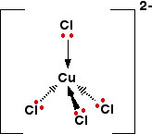
Complex Formation
Lewis base
lone pair donor (ligands are Lewis bases)
Lewis acid
lone pair acceptor (transition metal ions are Lewis acids)
H⁺ + :OH⁻ → H₂O
Lewis
acid
Lewis
base
Ligands form co-ordinate bonds via lone pairs

Slide 25
Complex Formation
Monodentate ligands – form one co-ordinate bond
e.g. H₂O:, :OH⁻, :NH₃, :CN⁻, :Cl⁻
[Cu(H₂O)₆]²⁺
[CuCl₄]²⁻

Slide 26
Complex Formation
Bidentate ligands – form two co-ordinate bonds
1,2-diaminoethane
(en, ethylenediamine, NH₂(CH₂)₂NH₂)
ethandioate
(ox²⁻, oxalate, C₂O₄²⁻)
[Cr(C₂O₄)₃]³⁻
[Cr(en)₃]³⁺

Slide 27
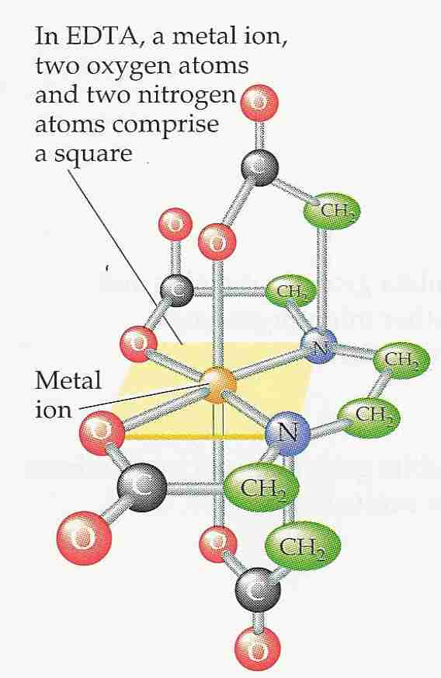
Complex Formation
Multidentate ligands – form several co-ordinate bonds (chelating agent)
EDTA⁴⁻
Ethylenediaminetetraacetic Acid
e.g. [Cu(EDTA)]²⁻

Slide 28
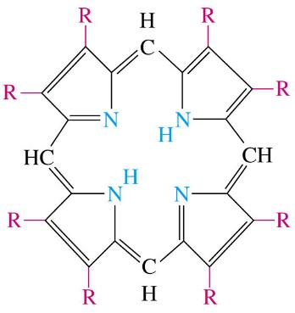
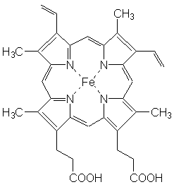
Complex Formation
Multidentate ligands – form several co-ordinate bonds
porphyrin
e.g. haem

Slide 29
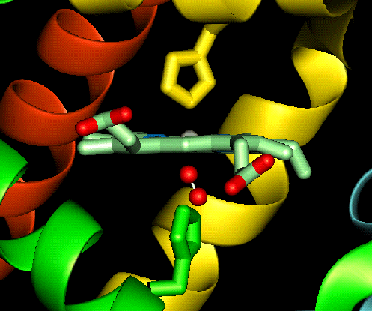
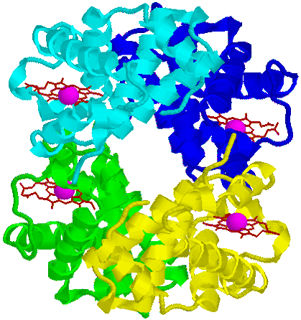
Complex Formation
Multidentate ligands – form several co-ordinate bonds
haemoglobin

Slide 30
Uses of Some Complexes
haemoglobin | Contains Fe²⁺ – allows O₂ to bond and carried to where needed
[Pt(NH₃)₂Cl₂] | cis platin – anti-cancer drug
[Ag(NH₃)₂]⁺ | Used in Tollen's reagent to distinguish aldehydes and ketones
[Ag(CN)₂] ⁻ | Used in silver electroplating
[Ag(S₂O₃)₂] ³⁻ | Formed in photography to remove unreacted AgX from the film

Slide 31
Shapes of Complex Ions
Co-ordination number | 2 | 4 | 4 | 6
Shape | linear | tetrahedral | square planar | octahedral
Bond angles
Occurrence
e.g.

Slide 32
Shapes of Complex Ions
Co-ordination number | 2 | 4 | 4 | 6
Shape | linear | tetrahedral | square planar | octahedral
Bond angles | 180º | 109.5º | 90º,180º | 90º, 180º
Occurrence | Ag⁺ complexes | Large ligands (e.g. Cl⁻, Br⁻) | Pt²⁺ complexes, Ni(CN)₄²⁻ | Most common
Hybridization of central ion | sp | sp³ | dsp² | sp³d², d²sp³
e.g. | [Ag(NH₃)₂]⁺ | [CuCl₄]²⁻ | [PtCl₄]²⁻ | [Cu(H₂O)₆]²⁺

Slide 33
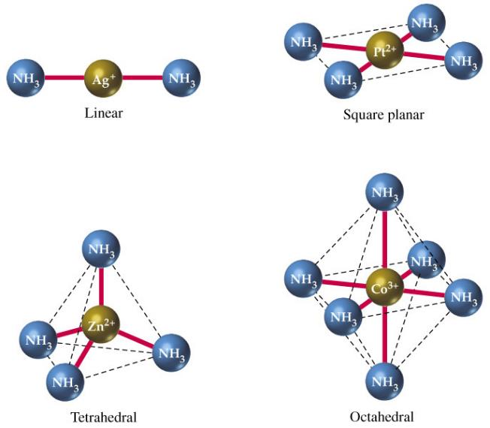
Shapes of Complex Ions

Slide 34
Naming of Complex Ions (Not Required)
1. When naming a complex ion, the ligands are named before the metal ion.
2. Write the names of the ligands in alphabetical order. (Numerical prefixes do not affect the order.)
Multiple occurring monodentate ligands receive a prefix according to the number of occurrences: di-, tri-, tetra-, penta-, or hexa. Polydentate ligands (e.g., ethylenediamine, oxalate) receive bis-, tris-, tetrakis-, etc.
Anions end in ido. This replaces the final 'e‘. When the anion ends with '-ate', e.g. sulfate becomes sulfato.
Neutral ligands are given their usual name, with some exceptions: NH₃ becomes ammine; H₂O becomes aqua or aquo; CO becomes carbonyl; NO becomes nitrosyl.

Slide 35
Naming of Complex Ions
3. Write the name of the central atom/ion. If the complex is an anion, the central atom's name will end in -ate, and its Latin name will be used if available (except for mercury).
4. If the central atom's oxidation state needs to be specified (when it is one of several possible, or zero), write it as a Roman numeral (or 0) in parentheses.
5. Name cation then anion as separate words (if applicable, as in last example)

Slide 36
Naming of Complex Ions
E.g.:
[NiCl₄]²⁻
tetrachloridonickelate(II) ion
[CuCl₅NH₃]³⁻
amminepentachloridocuprate(II) ion
[Cd(CN)₂(en)₂]
dicyanidobis(ethylenediamine)cadmium(II)
[CoCl(NH₃)₅]SO₄
pentaamminechloridocobalt(III) sulfate

Slide 37
For each of the following complexes:
Draw the complex.
Name the shape.
Give bond angles.
Give the oxidation number of the metal.
Give the coordination number.
Give the hybridization of the metal ion/atom.
(Name the complex).
[Ag(CN)₂]⁻
[Cr(NH₃)₆]³⁺
[Ni(en)₃]²⁺
[Co(en)₂Cl₂ ]⁺
[Pt(NH₃)₂Cl₂]
[Fe(C₂O₄)₃]⁴⁻

Slide 38
Linear
180º
Ag +1
Coordination number = 2
sp
Dicyanidosilverate ion
1
2
Octahedral
90º & 180º
Cr +3
Coordination number = 6
d²sp³
Hexaamminechromium(III) ion

Slide 39
Octahedral
90º & 180º
Ni +2
Coordination number = 6
sp³d²
Tris(ethylenediamine)nickel(II) ion
2+
3
Ni
Octahedral
90º & 180º
Co +3
Co-ordination number = 6
sp³d²
Dichloridobis-(ethylenediamine)cobalt(III) ion
4

Slide 40
Square planar
90º & 180º
Pt +2
Coordination number = 4
dsp²
Diamminedichloridoplatinum(II)
5
6
Octahedral
90º & 180º
Fe +2
Coordination number = 6
sp³d²
Tris(ethandioate)ferrate(II) ion

Slide 41
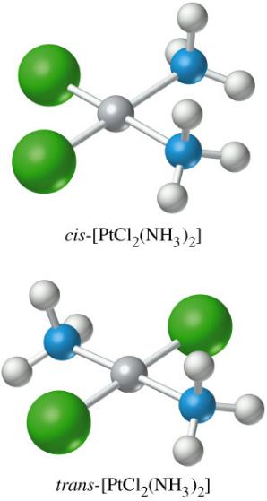
Shapes of Complex Ions
Geometric Isomerism
e.g. [PtCl₂(NH₃)₂]
cis
trans

Slide 42
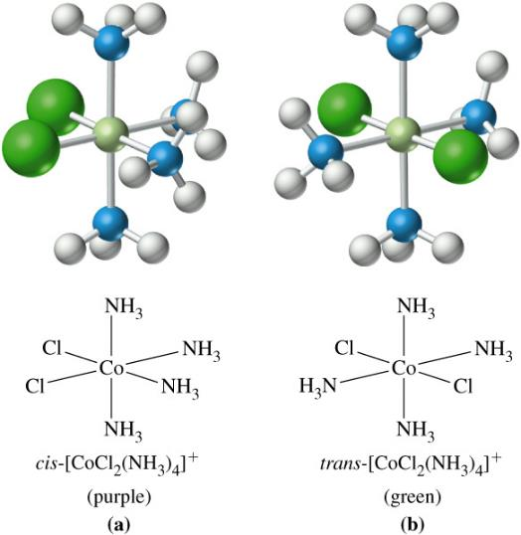
Shapes of Complex Ions
Geometric isomerism
e.g. [CoCl₂(NH₃)₄]⁺

Slide 43
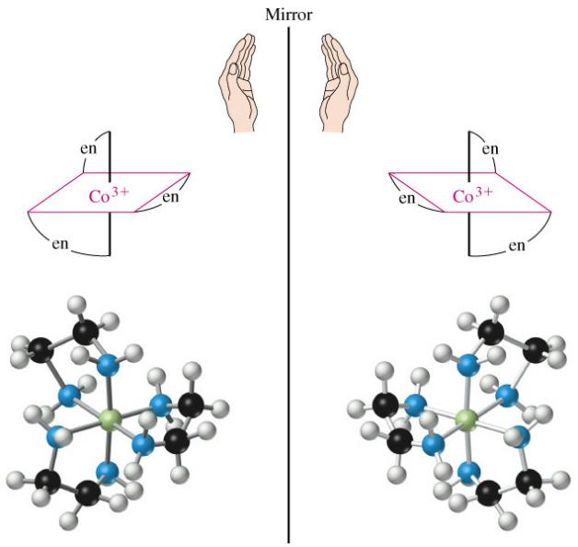
Shapes of Complex Ions
Optical Isomerism
e.g. [Co(en)₃]³⁺

Slide 44
Shapes of Complex Ions
Optical Isomerism

Slide 45

Chemical Properties of Transition Metals
4) They form coloured ions.

Slide 46
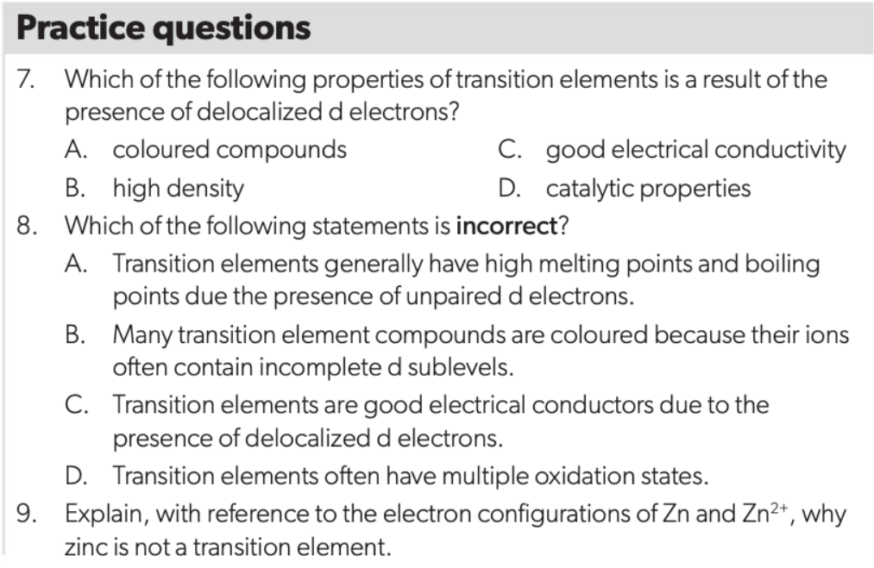

Slide 47
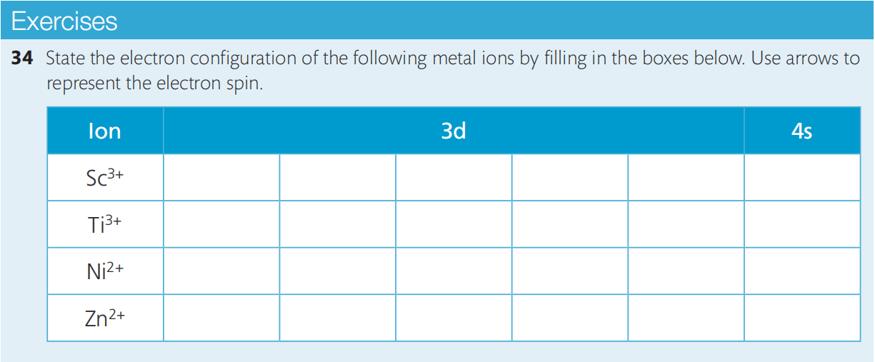
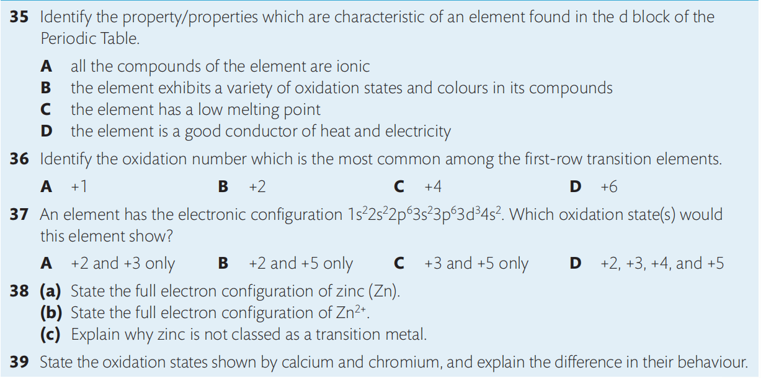

Slide 48
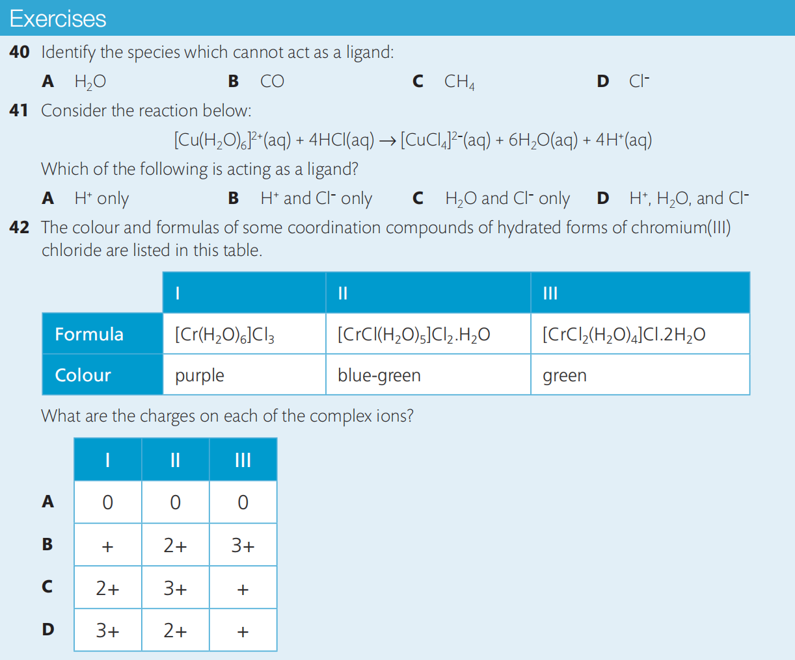

Slide 49
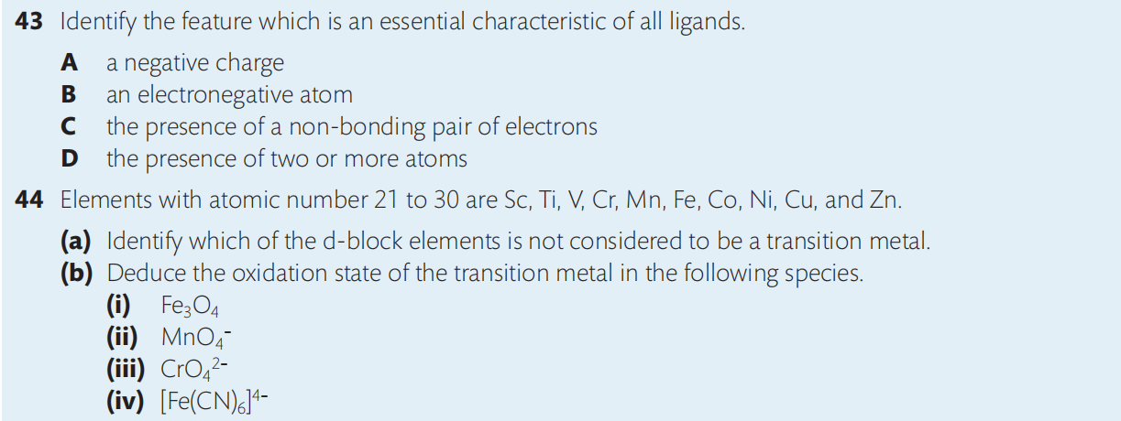
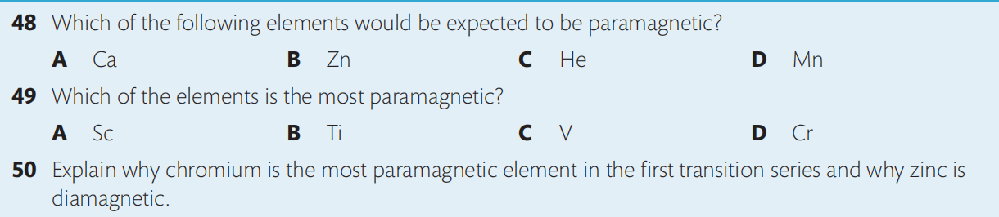
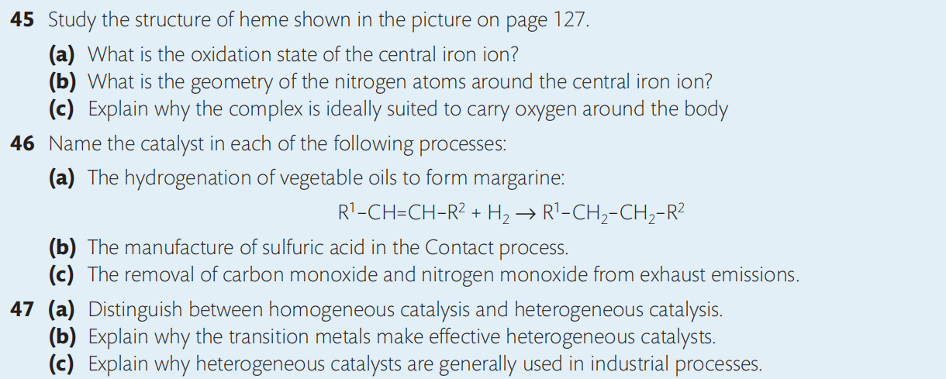

Slide 50
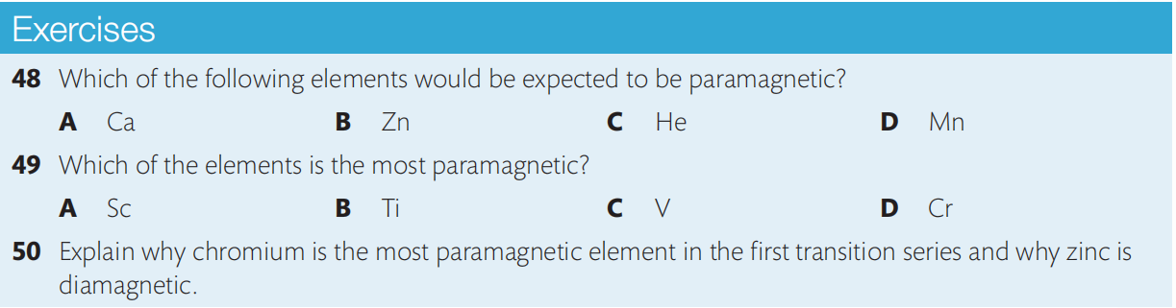
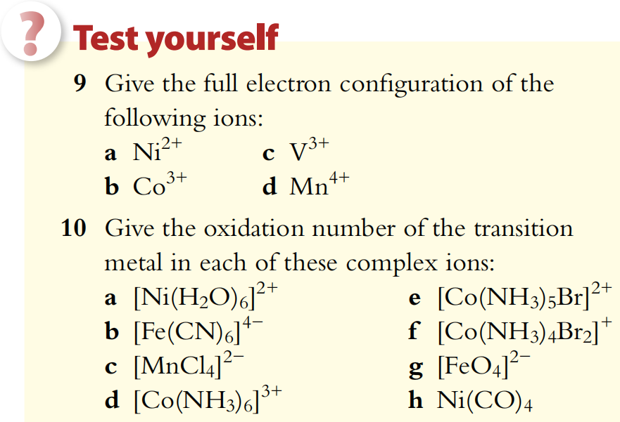
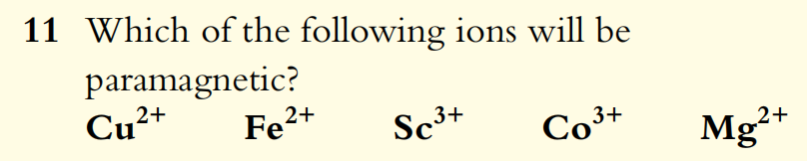
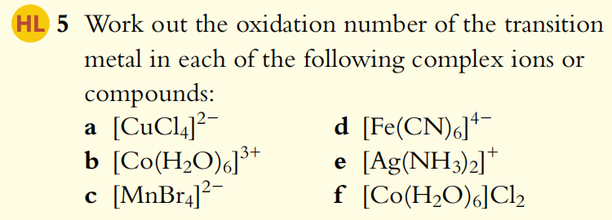

Slide 51
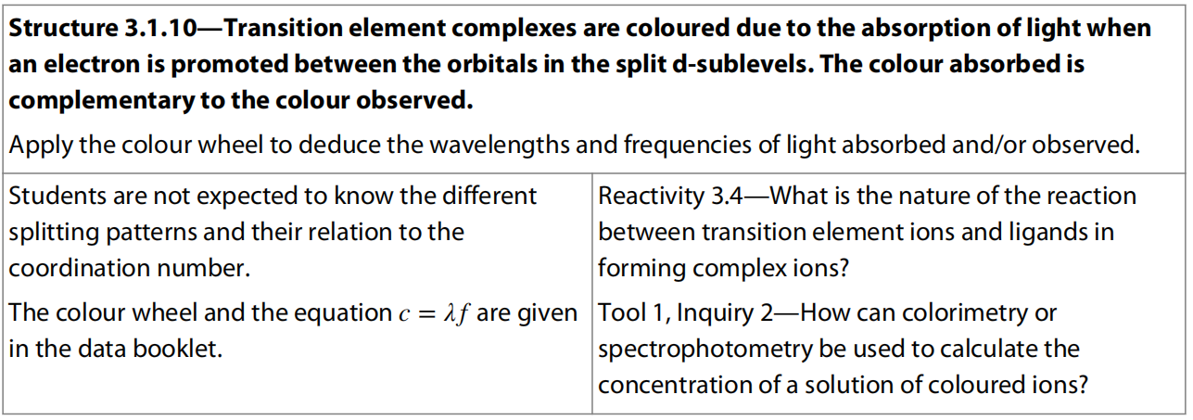
5.2 Colors of complexes

Slide 52
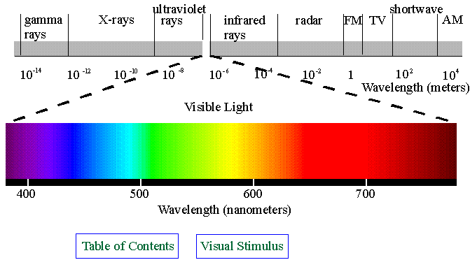
Formation of Colored Complex ions

Slide 53
Formation of Colored Complex ions
Once ligands bond, the five d orbitals are no longer have the same energy but are splitted into different sub-levels.
Energy = hν
If there is incomplete d subshell, then energy is absorbed to excite electrons from the d orbitals with lower energy to the d orbitals with higher energy.
This energy is in the UV/visible region.

Slide 54
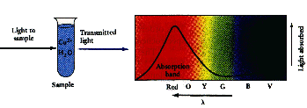
Formation of Colored Complex ions
The color we see is what is left after some colours are absorbed by the metal to excite electrons.
This color is complementary color of the color absorbed.

Slide 55
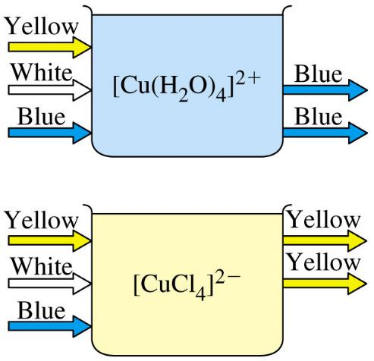
Formation of Colored Complex ions
6

Slide 56
Factors affecting colors of complex ions
The size of the energy gap between the splitted d-orbitals, and so the colour is affected by changes in:
1) the identity of metals and so the number of protons
[Fe(H₂O)₆]³⁺
[Mn(H₂O)₆]²⁺
Yellow brown
Pale pink

Slide 57
Factors affecting colors of complex ions
2) the oxidation state and so the number
of d electrons
[Fe(H₂O)₆]³⁺
[Fe(H₂O)₆]²⁺
Yellow brown
Pale green

Slide 58
Factors affecting colors of complex ions
The two combined to show the charge on the transition metal ion.
The higher the ionic charge, the more closely the ligands would be attracted by the metal ion, and so the greater gap between splitted d-orbitals would be created.

Slide 59
Factors affecting colors of complex ions
3) The identity of the ligands and so the charge density of the lone pair electrons provided by the ligands.
Mostly the smaller the donating atom, the lower the electronegativity, the greater the negative charge all would lead to the greater charge density of the lone pair electrons provided.
[Cu(H₂O)₆]²⁺
[Cu(H₂O)₂(NH₃)₄ ]²⁺
blue
deep blue
≈

Slide 60
Factors affecting colors of complex ions
4) the coordination number and so the geometry of the complex
The different geometry of the complex would lead to totally different splitting patterns.
Be aware that this would NOT likely to occur alone.
[Cu(H₂O)₆]²⁺
[CuCl₄ ]²⁻
blue
yellow

Slide 61
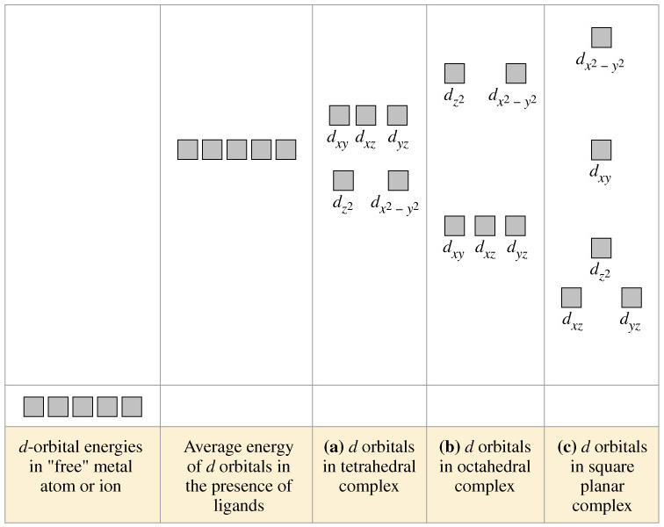
Factors affecting colors of complex ions
Energy

Slide 62
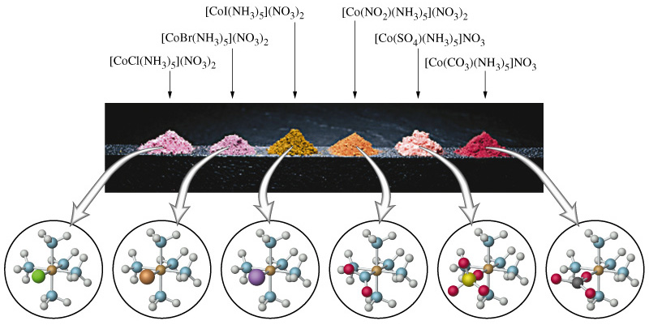
Factors affecting colors of complex ions

Slide 63
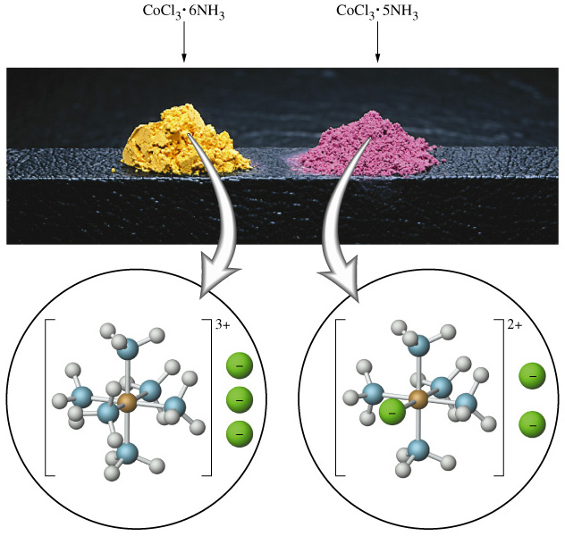
Factors affecting colors of complex ions
[Co(NH₃)₆]Cl₃
[Co(NH₃)₅Cl]Cl₂

Slide 64
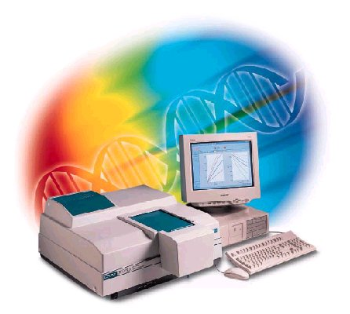
Measuring Colorsof Complex ions
UV/Visible spectroscopy
Frequencies/wavelength at which complexes absorb can be measured by UV/visible spectroscopy.
Light is passed through complex and the amount passing through measured.

Slide 65
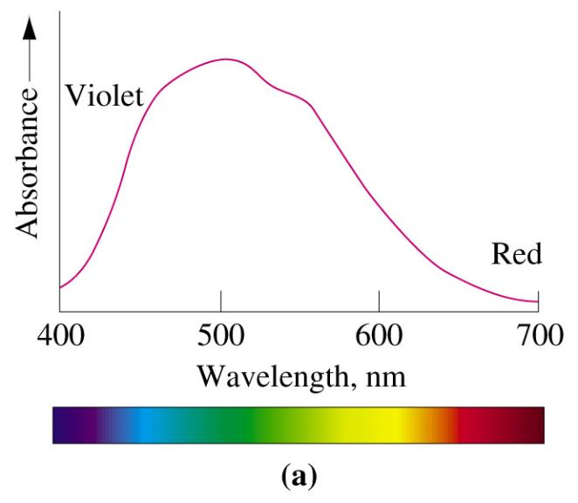
Measuring Colors of Complex ions

Slide 66
Measuring Concentration of Complex ions
Colorimetry
The more concentrated the solution, the more it absorbs.
This can be used to find the concentration of solutions – this is done in a colorimeter/spectrophotometer.
For some ions, a ligand is added to intensify the colour.
The strength of absorbance of solutions of known concentration is measured and a calibration curve/line produced.
The two normally form a directly proportional relationship under certain concentration region (not too high conc.).
The concentration of a solution of unknown concentration can be found by measuring the absorption and using the graph.

Slide 67
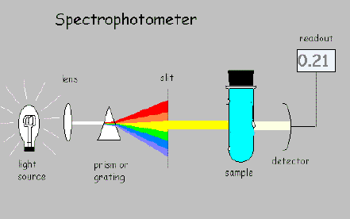
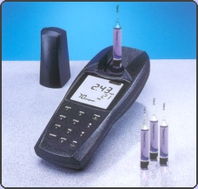
Measuring Concentration of Complex ions
Colorimetry

Slide 68
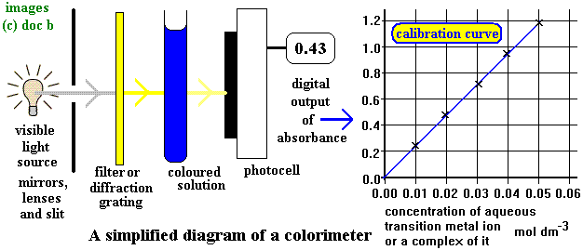
Measuring Concentration of Complex ions

Slide 69
Use of Color Wheel
Color Wheel
The color absorbed and the color observed are on the opposite side of the color wheel.
The complemetary color of the color absorbed would be observed.
Be aware the gap of wavelength/frequency between red and violet region.

Slide 70
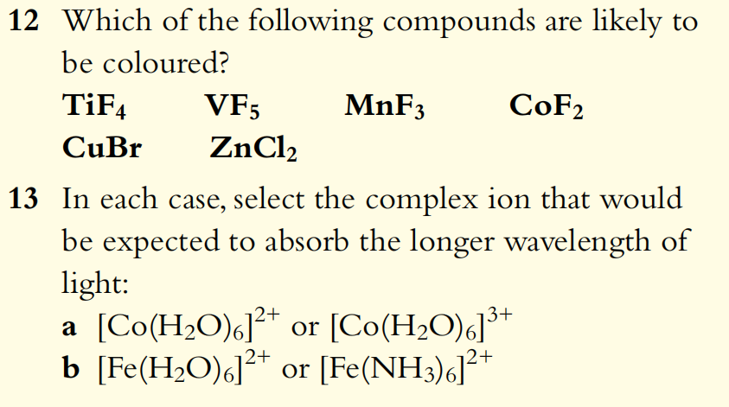

Slide 71
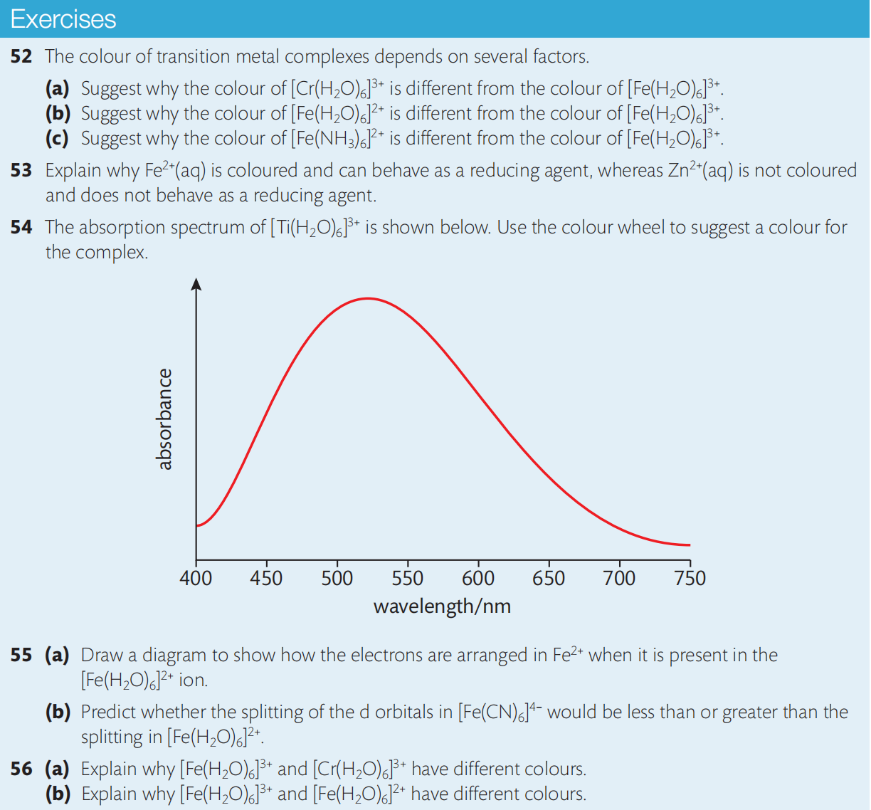

Slide 72
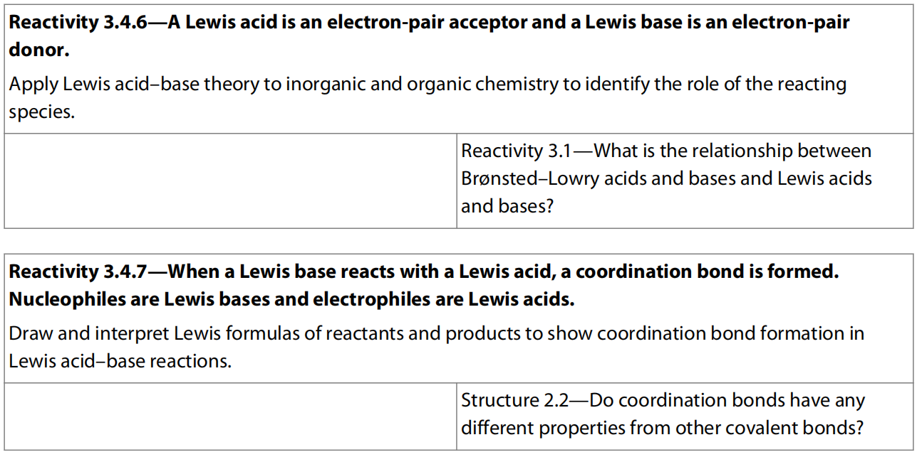
5.3 Lewis Acids and Bases

Slide 73
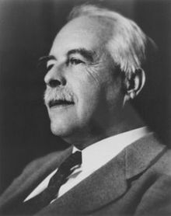
Lewis acids and bases (1923)
A Lewis acid is a species that accepts a pair of electrons (electron pair acceptor) to form a dative bond.
(All Brønsted-Lowry acids are in fact Lewis acids since H⁺ is a typical Lewis acid).
A Lewis base is a substance that donate the electron pair (electron pair donor) to form dative bond to Lewis acids
(This extended the range of acid-base reactions beyond those involving the transfer of a H⁺ to include all reactions involving the formation of a dative bond).
Gilbert Newton Lewis (U.S.)
Though nominated 35 times, He never won the Nobel Prize in Chemistry.

Slide 74

The curly arrow (shown in blue) is a convention used to show donation of a pair of electrons.
H⁺ is acting as an electron pair acceptor and the nitrogen atom in ammonia is acting as an electron pair donor.

Slide 75
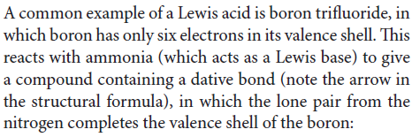
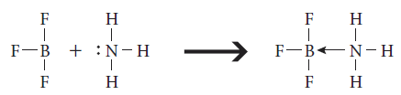

Slide 76
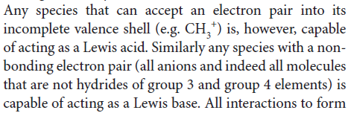



Slide 77
Comparison of Brønsted–Lowry and Lewis theories of acids and bases
Although all Brønsted–Lowry acids are Lewis acids, not all Lewis acids are Brønsted–Lowry acids. The term Lewis acid is usually reserved for those species which can only be described by Lewis theory, that is those that do not release H⁺.
Many reactions cannot be described as Brønsted–Lowry acid–base reactions, but do qualify as Lewis acid–base reactions. These are reactions where no transfer of H⁺ occurs.

Slide 79
